Slide 1
Firewalls
CS 6262 Spring 02 - Lecture #19
(Tuesday, 3/26/2002)

Slide 2
Firewall Technologies
Julie Schneider

Slide 3

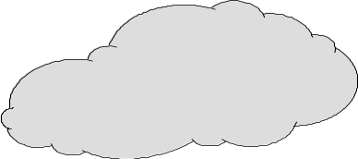

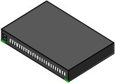

What is a firewall?
Device that provides secure connectivity between networks (internal/external; varying levels of trust)
Used to implement and enforce a security policy for communication between networks
Untrusted Networks & Servers
Trusted Networks
Firewall
Untrusted Users
Internet
Intranet
Router
DMZ
Public Accessible Servers & Networks
Trusted Users

Slide 4
Firewalls
From Webster’s Dictionary: a wall constructed to prevent the spread of fire
Internet firewalls are more the moat around a castle than a building firewall
Controlled access point

Slide 5
Firewalls can:
Restrict incoming and outgoing traffic by IP address, ports, or users
Block invalid packets

Slide 6
Convenient
Give insight into traffic mix via logging
Network Address Translation
Encryption

Slide 7
Firewalls Cannot Protect…
traffic that does not cross it
  routing around
  Internal traffic
when misconfigured

Slide 8


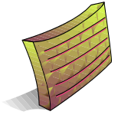



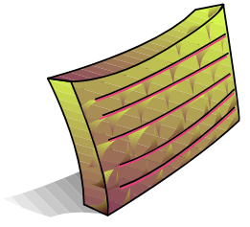


Access Control
Corporate
Network
ALERT!!
ALERT!!
ALERT!!
Internet
Security Requirement
Control access to network information and resources
Protect the network from attacks
DMZ Net
Web Server Pool

Slide 9
Filtering
Packets checked then passed
Inbound & outbound affect when policy is checked
Notes:
Sun Microsystems SunScreen Firewall is an exception. It functions as a bridge instead of a router. See http://www.sun.com/security.

Slide 10
Filtering
Packet filtering
  Access Control Lists
Session filtering
  Dynamic Packet Filtering
  Stateful Inspection
  Smart packet filtering
  Context Based Access Control

Slide 11
Filtering
Fragmentation/reassembly
Sequence number checking
ICMP

Slide 12
Packet Filtering
Decisions made on a per-packet basis
No state information saved

Slide 13
Typical Configuration
Ports > 1024 left open
If dynamic protocols are in use, entire ranges of ports must be allowed for the protocol to work.

Slide 14
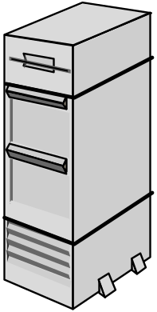

Packet Filter
Applications
Applications
Presentations
Presentations
Sessions
Sessions
Transport
Transport
Network
Network
DataLink
DataLink
DataLink
Physical
Physical
Physical
Router

Slide 15
Session Filtering
Packet decision made in the context of a connection
If packet is a new connection, check against security policy
If packet is part of an existing connection, match it up in the state table & update table

Slide 16
Typical Configuration
All denied unless specifically allowed
Dynamic protocols (FTP, H323, RealAudio, etc.) allowed only if supported

Slide 17
Session Filtering
Screens ALL attempts, Protects All applications
Extracts & maintains ‘state’ information
Makes an intelligent security / traffic decision
Applications
Applications
Presentations
Applications
Presentations
Sessions
Presentations
Sessions
Transport
Sessions
Transport
Network
Transport
Network
Network
DataLink
DataLink
DataLink
Physical
Physical
Physical
Dynamic State Tables
Dynamic State Tables
Dynamic State Tables
Notes:
efficient packet processing engine extract, analyze and maintain data from OSI layers 2 though 7 throughout a session in order to make comprehensive security decisions about that session. By maintaining packet information throughout the life of a session, state of a session from beginning to end.
No packet in the software stream is processed by any of the higher protocol stack layers unless verified that the packet complies with the security policy.

Slide 18
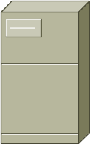
Telnet
Telnet Server
Telnet Client
23
1234
◆ Client opens channel to server; tells server its port number. The ACK bit is not set while establishing the connection but will be set on the remaining packets.
◆
“PORT 1234”
❖
“ACK”
❖ Server acknowleges.

Slide 19
Example: Telnet
Format:
access-list <rule number> <permit|deny> <protocol> <SOURCE host with IP address| any|IP address and mask> [<gt|eq port number>] <DEST host with IP address| any|IP address and mask> [<gt|eq port number>]
The following allows user to telnet from an IP address (172.168.10.11) to any destination, but not vice-versa:
access-list 100 permit tcp host 172.168.10.11 gt 1023 any eq 23
! Allows packets out to remote Telnet servers
access-list 101 permit tcp any eq 23 host 172.168.10.11 established
! Allows returning packets to come back in. It verifies that the ACK bit is set
interface Ethernet 0
access-list 100 out ! Apply the first rule to outbound traffic
access-list 101 in ! Apply the second rule to inbound traffic
!
Note: anything not explicitly permitted in an access-list is denied.

Slide 20
FTP
FTP Server
FTP Client
20
Data
21
Command
5150
5151
◆ Client opens command channel to server; tells server second port number.
◆
“PORT 5151”
❖
⬥
“OK”
❖ Server acknowleges.
DATA CHANNEL
⬥ Server opens data channel to client’s second port.

TCP ACK
 Client Acknowledges.
Notes:
From Zwicky, Building Internet Firewalls, second edition page 456

Slide 21
Example FTP – Packet Filter
Format:
access-list <rule number> <permit|deny> <protocol> <SOURCE host with IP address| any|IP address and mask> [<gt|eq port number>] <DEST host with IP address| any|IP address and mask> [<gt|eq port number>]
The following allows a user to FTP (not passive FTP) from any IP address to the FTP server (172.168.10.12) :
access-list 100 permit tcp any gt 1023 host 172.168.10.12 eq 21
access-list 100 permit tcp any gt 1023 host 172.168.10.12 eq 20
! Allows packets from any client to the FTP control and data ports
access-list 101 permit tcp host 172.168.10.12 eq 21 any gt 1023
access-list 101 permit tcp host 172.168.10.12 eq 20 any gt 1023
! Allows the FTP server to send packets back to any IP address with TCP ports > 1023
interface Ethernet 0
access-list 100 in ! Apply the first rule to inbound traffic
access-list 101 out ! Apply the second rule to outbound traffic
!

Slide 22
FTP – Passive Mode
FTP Server
FTP Client
20
Data
21
Command
5150
5151
◆ Client opens command channel to server; requests passive mode.
◆
“PASV”
❖
❖ Server allocates port for data channel; tells client port number.
“OK 3267”
⬥
DATA CHANNEL
⬥ Client opens data channel to server’s second port.

TCP ACK
 Server Acknowledges.
Notes:
From Zwicky, Building Internet Firewalls, second edition page 457

Slide 23
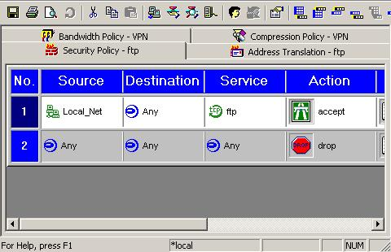
Example FTP : Session Filter

Slide 24
Proxy Firewalls
Relay for connections
Client Proxy Server
Two flavors
  Application level
  Circuit level

Slide 25
Application Gateways
Understands specific applications
  Limited proxies available
  Proxy ‘impersonates’ both sides of connection
Resource intensive
  process per connection
HTTP proxies may cache web pages

Slide 26
Application Gateways
More appropriate to TCP
ICMP difficult
Block all unless specifically allowed
Must write a new proxy application to support new protocols
  Not trivial!

Slide 27
Application Gateways
Clients configured for proxy communication
Transparent Proxies

Slide 28
Application Layer GW/proxy
Telnet
FTP
HTTP
Applications
Applications
Applications
Presentations
Presentations
Presentations
Sessions
Sessions
Sessions
Transport
Transport
Transport
Network
Network
Network
DataLink
DataLink
DataLink
Physical
Physical
Physical
Application Gateway

Slide 29
Circuit-Level Gateways
Support more services than Application-level Gateway
  less control over data
Hard to handle protocols like FTP
Clients must be aware they are using a circuit-level proxy
Protect against fragmentation problem

Slide 30
SOCKS
Circuit level Gateway
Support TCP
SOCKS v5 supports UDP, earlier versions did not
See http://www.socks.nec.com

Slide 31
Comparison
 | Security | Performance | Service Support
Packet Filter | 3 | 1 | No dynamic w/o holes
Session Filter | 2 | 2 | Dependent on vendor for dynamic support
Circuit GW | 2 | 3
App. GW | 1 | 4 | Typically < 20
Lower is better for security & performance

Slide 32
Comparison
 | Modify Client Applications?
Packet Filter | No
Session Filter | No
Circuit GW | Typical, SOCKS-ify client applications
App. GW | Unless transparent, client application must be proxy-aware & configured

Slide 33
Comparison
 | ICMP | Fragmen-tation
Packet Filter | Yes | No
Session Filter | Yes | Maybe
Circuit GW | (SOCKS v5) | Yes
App. GW | No | yes

Slide 34
Firewall Technologies (II)

Slide 35
Proxying UDP/ICMP
Why isn’t UDP or ICMP proxied as much as TCP?
TCP’s connection-oriented nature easier to proxy
UDP & ICMP harder (but not impossible) since each packet is a separate transaction
Session filters determine which packets appear to be replies

Slide 36
FTP & Proxies
Not enough to read FTP PORT command
Port could be in use on proxy already, must pick new port

Slide 37
Circuit Level GW
Operate at user level in OS
Have circuit program ‘route’ packets between interfaces instead of OS routing code

Slide 38
NAT
Useful if organization does not have enough real IP addresses
Extra security measure if internal hosts do not have valid IP addresses (harder to trick firewall)
Only really need real IP addresses for services outside networks will originate connections to

Slide 39
NAT
Many-to-1 (n-to-m) mapping
1-to-1 (n-to-n) mapping
Proxies provide many-to-1
NAT not required on filtering firewalls

Slide 40
Encryption (VPNs)
Allows trusted users to access sensitive information while traversing untrusted networks
Useful for remote users/sites
IPSec

Slide 41
Encrypted Tunnels
What kind of traffic allowed? Only IP?
Can the tunnel traffic be examined? Or are firewalls blind to internal tunnel traffic?
Can services and users be limited in their tunnel traffic?

Slide 42
Attacks
Take advantage of allowed client-server communications
Get around connections

Slide 43
IP Spoofing
Intruder attempts to gain access by altering a packet’s IP address to make it appear as though the packet originated in a part of the network with higher access privileges

Slide 44
Anti-Spoofing
Must have network level access to packets
Match up packets with allowed addresses per interface
With proxies, the IP headers are lost and never reach the application level

Slide 45
Anti-Spoofing
Internet
e4
130.207.5.0
130.207.3.0
e3
e2
e1
Allowed Networks:
E1: 130207.4.0/24
E2: 130.207.3.0/24
E3: 130.207.5.0/24
E4: All except E1,E2,E3
130.207.4.0

Slide 46
Mitnick & Shimomura
IP spoofing
Sequence number prediction
See http://www.takedown.com

Slide 47
Fragmentation: The 1st Wave
Telnet Server
Telnet Client
,  Send 2 fragments with the ACK bit set; when the server re-assembles the packet, the fragment offset are chosen so the full datagram forms a packet with the SYN bit set (the fragment offset of the second packet overlaps into the space of the first packet)
23
Allow only if ACK bit set
1234
◆
FRAG1 (with ACK)
❖
FRAG2 (with ACK)
SYN packet (no ACK)
⬥
ACK
⬥ All following packets will have the ACK bit set

Slide 48
Fragmentation
Data Link Layer Header
Ver/IHL | Type of Service | Total Length
Identifier |  | Flags | Fragment Offset
Time To Live | Protocol | Header Checksum
Source Address
Destination Address
Options + Padding
Source Port |  | Destination Port
Sequence Number
Acknowledgement Number
Offset/Reserved | U A P R S F | Window
Checksum |  | Urgent Pointer
Options + Padding
Data
Data Link Layer Trailer
IP Header
IP Datagram
TCP Header

Slide 49
Fragemtation: 2nd Wave
Instead fragmenting TCP header, fragment data portion or ICMP to attack OS of clients
OS – not all do bounds checking ‘early Friday bug’
  oversized ICMP reassembled on client too large, caused buffer overrun and BSOD
Fragment a URL or ftp put command
  Proxy would catch

Slide 50
Chargen Service
Character Generation, debugging tool
  Make a connection & receive a stream of data
Trick machine into making a connection to itself
  CPU locks
Anti-spoofing will catch

Slide 51
Sendmail
Typically handled by a proxy
Almost never want the outside world to have direct access to sendmail

